Slide 1
Unit 5

Slide 2
Market Basket Analysis in Data Mining
Market Basket Analysis is the process of discovering associations or patterns among items bought together by customers. It is mainly based on Association Rule Mining techniques in data mining.
Example
If customers frequently buy:
Bread + Butter
Milk + Bread
then the store may place these products nearby or provide combo offers.

Slide 3
Objectives of Market Basket Analysis
Identify customer purchasing patterns
Improve product placement
Increase cross-selling opportunities
Enhance customer satisfaction
Boost sales and profit
Design promotional offers and discounts

Slide 4
Working Principle
The analysis studies transaction data collected from customer purchases. It identifies:
Frequent itemsets → items often purchased together
Association rules → relationships among products

Slide 5
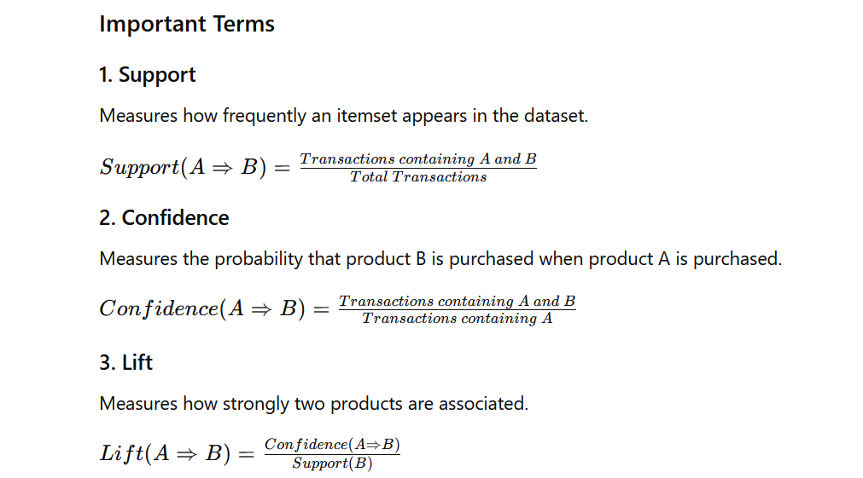

Slide 6
Applications of Market Basket Analysis
1. Sales and Marketing
Improves customer service
Helps in cross-selling products
Increases response rates in promotions and direct marketing
2. Customer Retention
Identifies customer behavior patterns
Predicts possible customer defections
Helps companies maintain loyal customers
3. Risk Assessment and Fraud Detection
Detects unusual purchasing behavior
Identifies fraudulent activities
Helps in security and monitoring systems
4. Store Layout Design
Products frequently bought together are placed nearby
Improves shopping convenience
5. Recommendation Systems
Used in online shopping platforms such as:
“Customers who bought this also bought…”

Slide 7
Advantages
Increases sales and revenue
Improves customer satisfaction
Supports better decision-making
Helps in targeted marketing
Easy to implement with transaction data
Limitations
Requires large amounts of data
Patterns may change over time
Rare item combinations may be ignored
Incorrect analysis may lead to poor business decisions

Slide 8
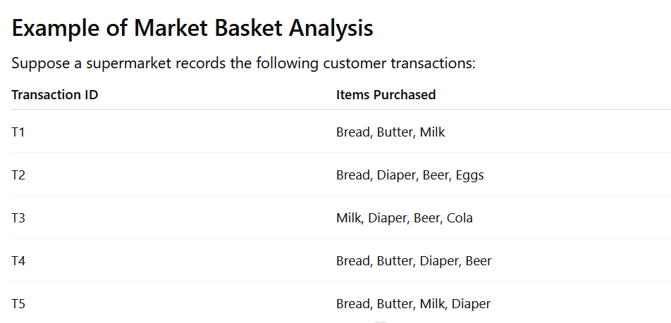

Slide 9
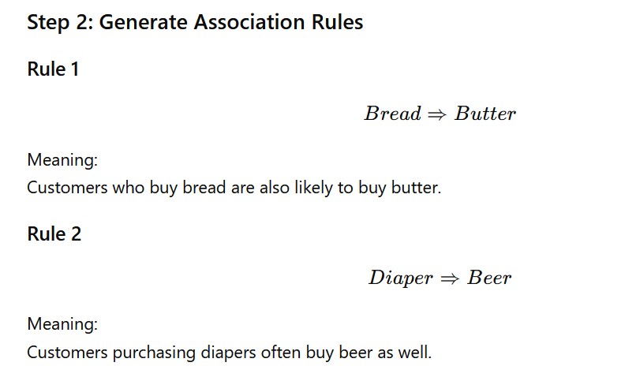
Step 1: Identify Frequent Itemsets
From the transactions, we observe:
Bread and Butter appear together in:
T1
T4
T5
So, Bread + Butter is a frequent itemset.
Diaper and Beer appear together in:
T2
T3
T4
So, Diaper + Beer is another frequent itemset.

Slide 10
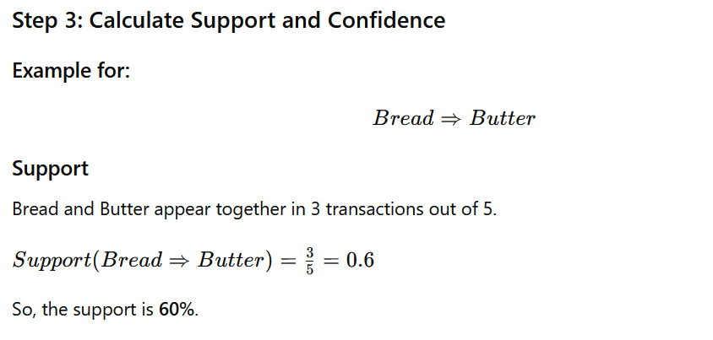
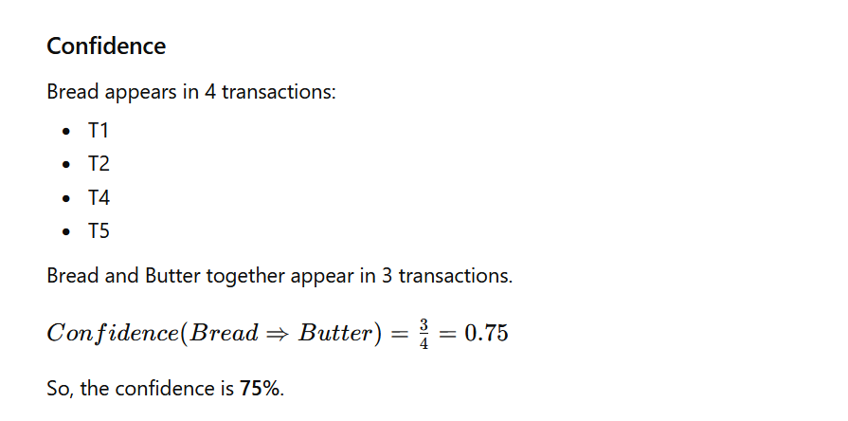

Slide 11
Business Interpretation
The supermarket can use this information to:
Place bread and butter near each other Offer combo discounts
Recommend butter when customers buy bread
Increase sales through cross-selling
Real-Life Example
Online shopping websites such as Amazon use Market Basket Analysis for recommendations like:
“Customers who bought this product also bought...”

Slide 12
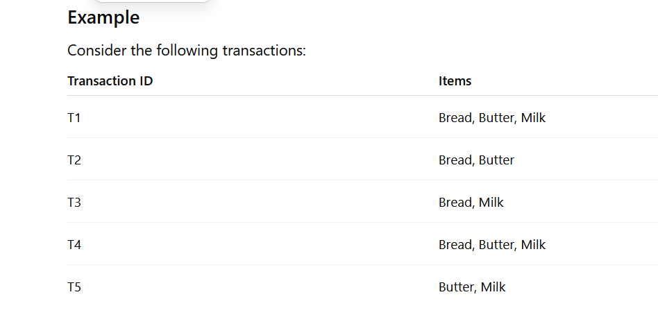
Frequent Itemsets and Closed Itemsets
1. Frequent Itemsets
A Frequent Itemset is a group of items that appear together in transactions more frequently than a minimum threshold called minimum support.
If the occurrence frequency of an itemset is greater than or equal to the minimum support value, it is called a frequent itemset.
Suppose minimum support = 2

Slide 13
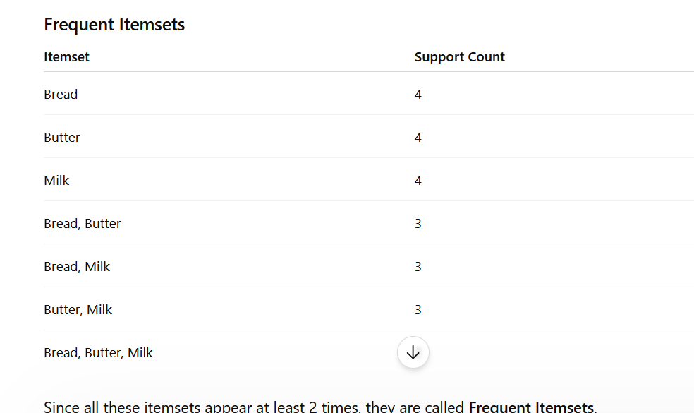

Slide 14
2. Closed Itemsets
A Closed Itemset is a frequent itemset for which no superset has the same support count.
An itemset is called closed if there is no larger itemset containing it with the same support.

Slide 15
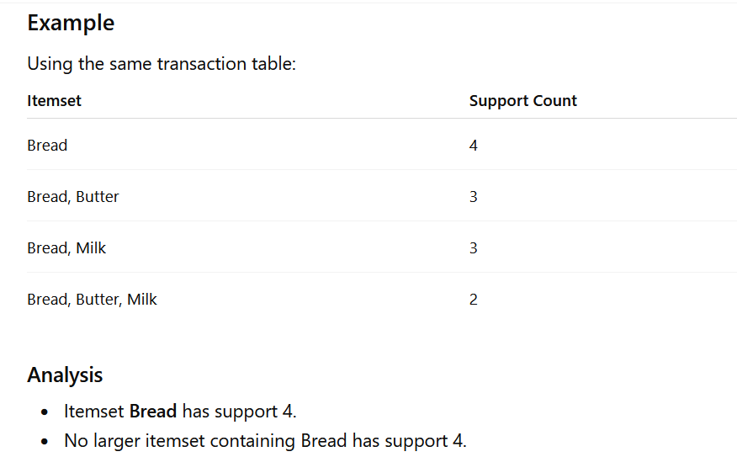
Therefore:
Bread is a Closed Itemset.

Slide 16
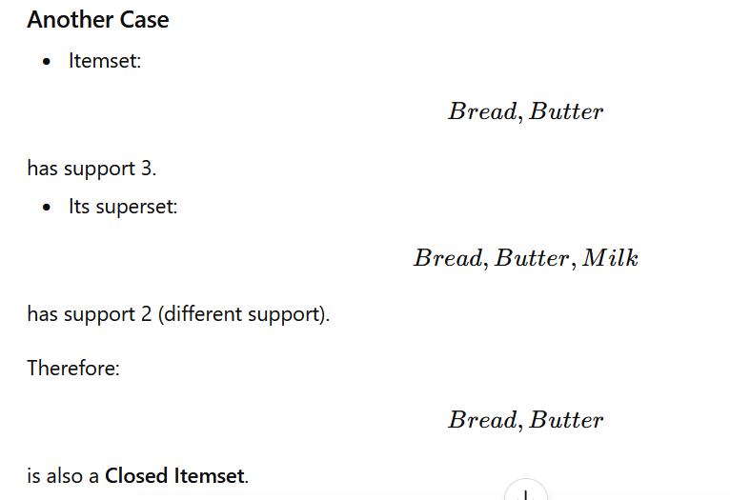

Slide 17
Association Rules
Association rule mining is a data mining technique used to discover interesting relationships, patterns, or associations among items in large databases.
It is widely used in market basket analysis, recommendation systems, web usage mining, and business analytics.
An association rule is generally written in the form:
X→Y
where:
X = antecedent (if part)
Y = consequent (then part)
This means that if item X occurs, item Y is likely to occur as well.
Example:
Bread → Butter
It means customers who buy bread also tend to buy butter.

Slide 18
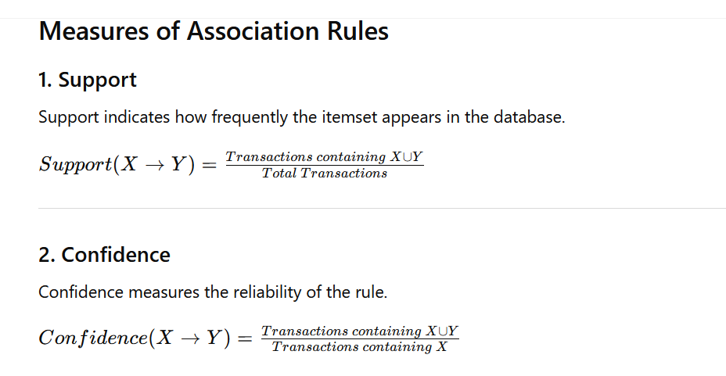

Slide 19
Types of Association Rules
1. Single Dimensional Association Rule
A single-dimensional association rule contains only one predicate or dimension.
Example
buys(X,"Laptop")→buys(X,"Mouse")
This rule only considers the buying dimension.
Characteristics
Uses one type of relationship
Simple and easy to analyze
Mostly used in market basket analysis
Applications
Supermarket sales analysis
Product recommendation systems
2. Multidimensional Association Rule
A multidimensional association rule involves two or more dimensions or predicates.
Example
Age(20−30)∧Occupation(Student)→buys(Laptop)
This rule includes:
Age dimension
Occupation dimension
Buying behavior
Characteristics
Uses multiple attributes
More informative than single-dimensional rules
Helps in customer segmentation
Applications
Customer profiling
Business intelligence
Decision support systems

